Slide 1
Chapter 4:
Intellectual Property

Slide 2
4.1 Introduction
1-<number>

Slide 3
Information Technology Changing Intellectual Property Landscape
Value of intellectual properties much greater than value of media
  Creating first copy is costly
  Duplicates cost almost nothing
Illegal copying pervasive
  Internet allows copies to spread quickly and widely
In light of advances in information technology, how should we treat intellectual property?
1-<number>

Slide 4
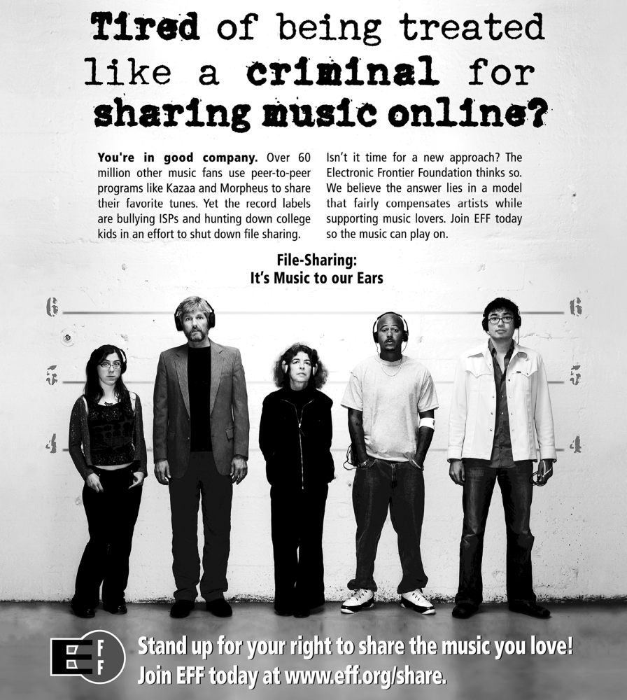
Reproduced by permission of Electronic Frontier Foundation via Creative Commons Attribution License 3.0. Go to www.eff.org/copyright for redistribution information. To access the original work, go to w2.eff.org/IP/P2P/?f=music-to-our-ears.html
1-<number>

Slide 5
4.2 Intellectual Property Rights
1-<number>

Slide 6
What Is Intellectual Property?
Intellectual property: any unique product of the human intellect that has commercial value
  Books, songs, movies
  Paintings, drawings
  Inventions, chemical formulas, computer programs
Intellectual property ≠ physical manifestation
IP is intangible personal property
Does right to own property extend to intellectual property?
1-<number>

Slide 7
Property Rights
Locke: The Second Treatise of Government
People have a right…
  to property in their own person
  to their own labor
  to things which they remove from Nature through their labor
As long as…
  nobody claims more property than they can use
  after someone removes something from common state, there is plenty left over
1-<number>
Notes:
appropriate

Slide 8
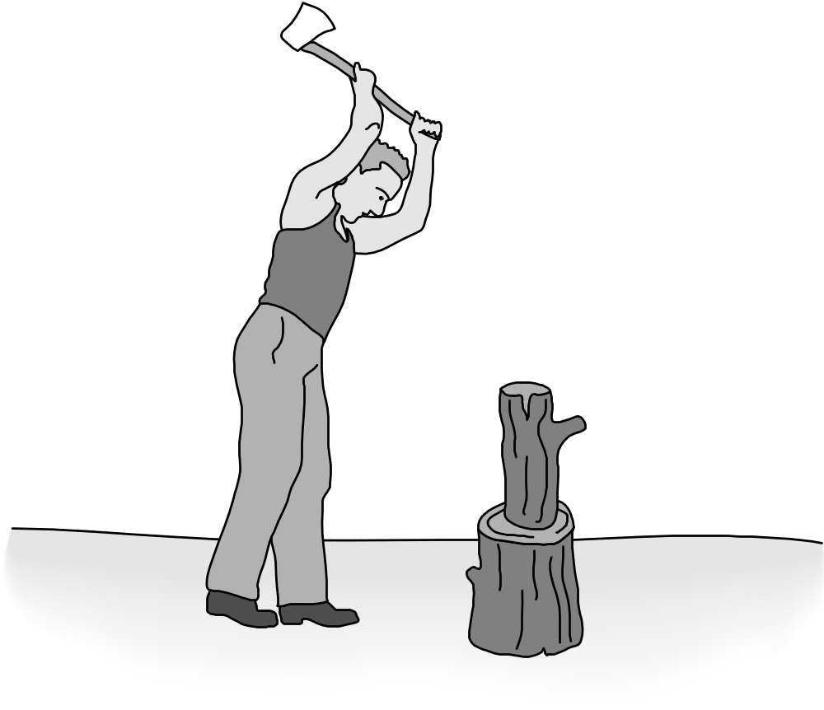
Locke’s Notion of Property Rights
1-<number>

Slide 9
Expanding the Argument to Intellectual Property
Writing a play akin to making a belt buckle
Belt buckle
  Mine ore
  Smelt it down
  Cast it
Writing a play
  “Mine” words from English language
  “Smelt” them into prose
  “Cast” them into a complete play
1-<number>

Slide 10
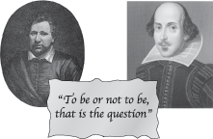
Analogy Is Imperfect
Ben Jonson, walker Art Library/Alamy; Shakespeare, Classic Image/Alamy
If Ben Jonson and William Shakespeare simultaneously write down Hamlet, who owns it?
If Ben “steals” the play from Will, both have it
These paradoxes weaken the argument for a natural right to intellectual property
1-<number>

Slide 11
Benefits of Intellectual Property Protection
Some people are altruistic (Regardful of others; unselfish); some are not
Allure of wealth can be an incentive for speculative work
Authors of U.S. Constitution recognized benefits to limited intellectual property protection
1-<number>

Slide 12
Limits to Intellectual Property Protection
Giving creators rights to their inventions stimulates creativity
Society benefits most when inventions in public domain
Law makers have struck a compromise by giving authors and inventors rights for a limited time
1-<number>

Slide 13
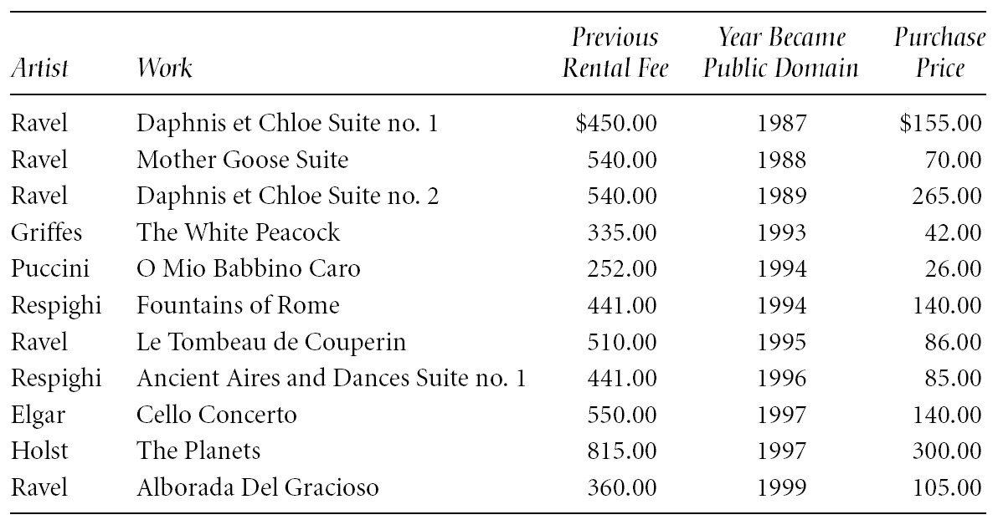
Prices Fall When Works Become Public Domain
Table from “Letter to The Honorable Senator Spencer Abraham,” by Randolph P. Luck from LUCK’S MUSIC LIBRARY. Copyright © 1996 by Randolph P. Luck. Reprinted with permission.
1-<number>

Slide 14
4.3 Protecting Intellectual Property
1-<number>

Slide 15
Trade Secret
Confidential piece of intellectual property that gives company a competitive advantage
Never expires
Not appropriate for all intellectual properties
Reverse engineering allowed
May be compromised when employees leave firm
1-<number>

Slide 16
Trademark, Service Mark
Trademark: Identifies goods
Service mark: Identifies services
Company can establish a “brand name”
Does not expire
If brand name becomes common noun, trademark may be lost
Companies advertise to protect their trademarks
Companies also protect trademarks by contacting those who misuse them
1-<number>

Slide 17
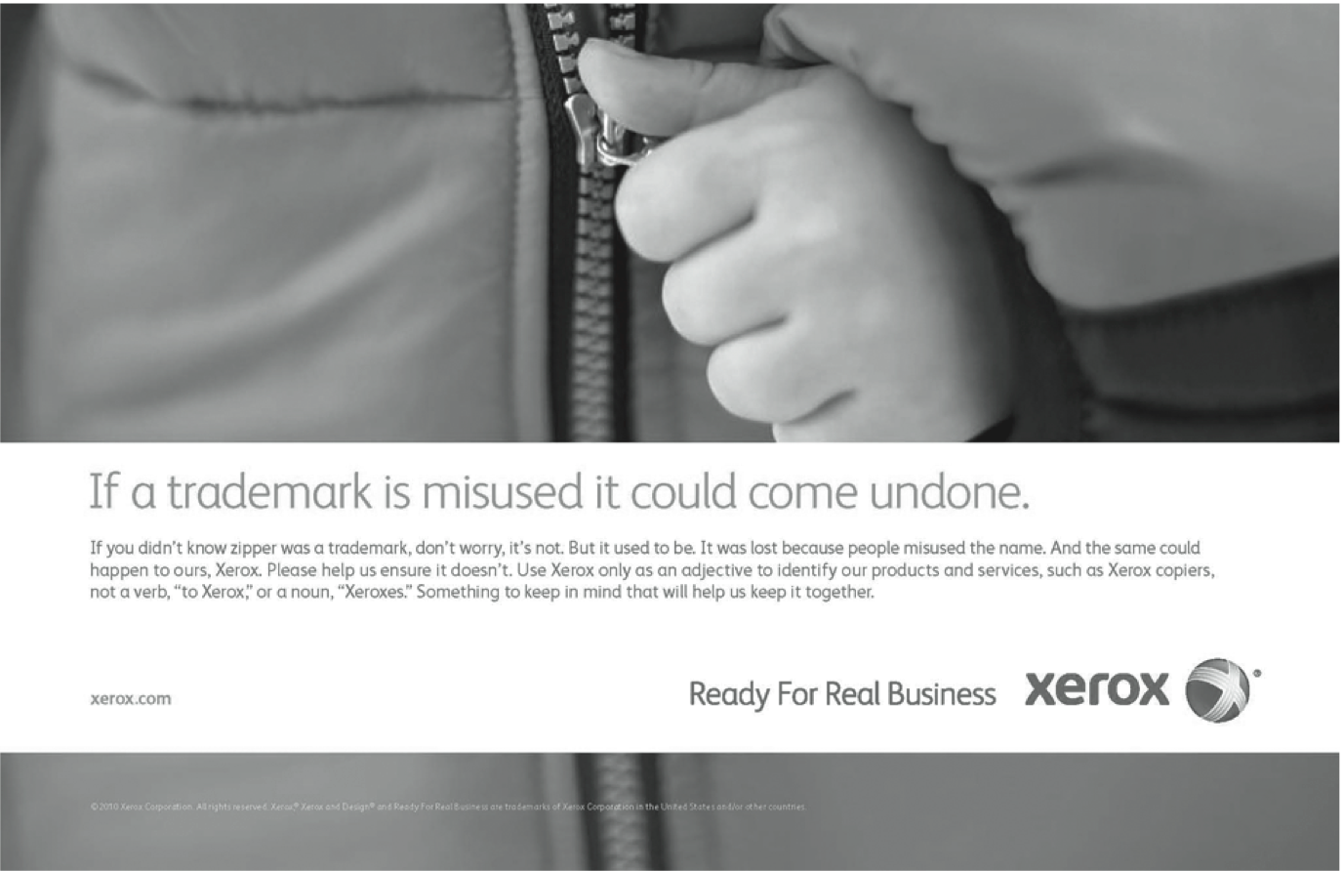
Screenshot by Xerox. Copyright © 2012 by Xerox Corporation. All rights reserved. Reprinted with permission.
1-<number>

Slide 18
Patent
A public document that provides detailed description of invention
Provides owner with exclusive right to the invention
Owner can prevent others from making, using, or selling invention for 20 years
1-<number>

Slide 19
Copyright
Provides owner of an original work five rights
  Reproduction
  Distribution
  Public display
  Public performance
  Production of derivative works
Copyright-related industries represent 6% of U.S. gross domestic product (> $900 billion/yr)
Copyright protection has expanded greatly since 1790
1-<number>

Slide 20
By permission of John Deering and Creators Syndicate, Inc.
1-<number>

Slide 21
Key Court Cases and Legislation
Gershwin Publishing v. Columbia Artists
Basic Books v. Kinko’s Graphics
Davey Jones Locker
No Electronic Theft Act
1-<number>

Slide 22
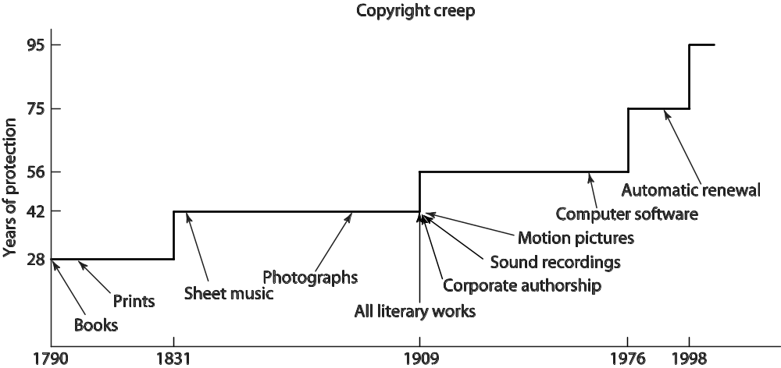
Copyright Creep
1-<number>

Slide 23
Copyright Creep
Since 1790, protection for books extended from 28 years to 95 years or more
Some say latest extension done to prevent Disney characters from becoming public domain
Group of petitioners challenged the Copyright Term Extension Act of 1998, arguing Congress exceeded Constitutional power
U.S. Supreme Court ruling
  CTEA does not create perpetual copyrights
  CTEA is constitutional
1-<number>

Slide 24
4.4 Fair Use
1-<number>

Slide 25
Fair Use Concept
Sometimes legal to reproduce a copyrighted work without permission
Courts consider four factors
  Purpose and character of use
  Nature of work
  Amount of work being copied
  Affect on market for work
1-<number>

Slide 26
Sony v. Universal City Studios
Sony introduced Betamax VCR (1975)
People started time shifting TV shows
Movie studios sued Sony for copyright infringements
U.S. Supreme Court ruled (5-4) that time shifting is fair use
1-<number>

Slide 27
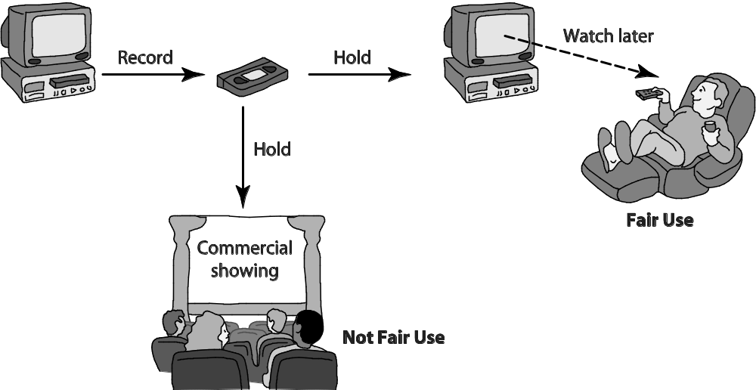
Time Shifting
1-<number>

Slide 28
Digital Recording Technology
Copying from vinyl records to cassette tapes introduced hiss and distortions
Introduction of compact disc a boon for music industry
  Cheaper to produce than vinyl records
  Higher quality
  Higher price ⇒ higher profits
BUT it’s possible to make a perfect copy of a CD
1-<number>

Slide 29
Audio Home Recording Act of 1992
Protects rights of consumers to make copies of analog or digital recordings for personal, noncommercial use
  Backup copy
  Give to family member
Digital audio recorders must incorporate Serial Copyright Management System (SCMS), so consumers can’t make a copy of a copy
1-<number>

Slide 30
RIAA v. Diamond Multimedia
MP3 compression allowed songs to be stored in 10% of the space, with little degradation
Diamond introduced Rio MP3 player (1998)
People started space shifting their music
RIAA started legal action against Diamond for violation of the Audio Home Recording Act
U.S. Court of Appeals, 9th Circuit, affirmed that space shifting is consistent with copyright law
1-<number>

Slide 31
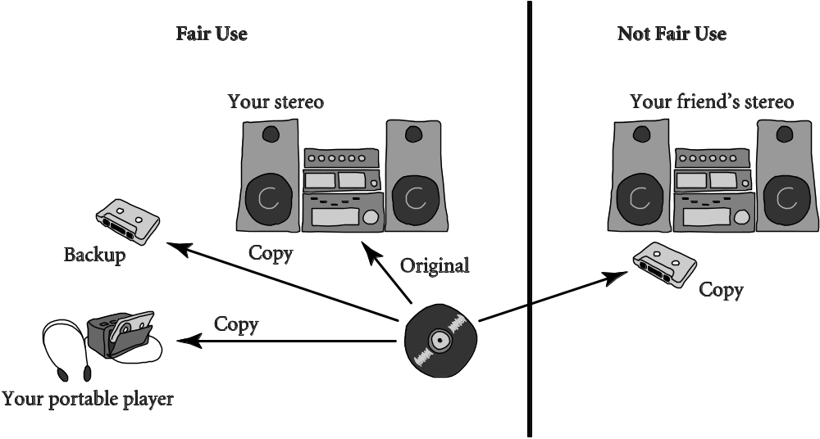
Space Shifting
1-<number>

Slide 32
Kelly v. Arriba Soft
Kelly: Photographer maintained Web site with copyrighted photos
Arriba Soft: Created search engine that returned thumbnail images
Kelly sued Arriba Soft for copyright infringement
U.S. Court of Appeals, 9th Circuit, affirmed that it was fair use
1-<number>

Slide 33
Google Books
Google announced plan to scan millions of books held by several huge libraries, creating searchable database of all words
If public domain book, system returns PDF
If under copyright, user can see a few sentences; system provides links to libraries and online booksellers
Authors Guild and publishers sued Google for copyright infringement (copying books for commercial reasons)
Out-of-court settlement reached
1-<number>

Slide 34
Benefits of Proposed Settlement
Google would pay $125 million to resolve legal claims of authors and publishers and establish Book Rights Registry
Readers would have much easier access to out-of-print books at U.S. public libraries and university libraries
University libraries could purchase subscriptions giving their students access to collections of some of world’s greatest libraries
Authors and publishers would receive payments earned from online access of their books, plus share of advertising revenues
1-<number>

Slide 35
Criticisms of Proposed Settlement
Google should have gone to court
  Google had a good case that its use was a fair use, based on precedent of Kelly v. Arriba Soft
  If Google had been found not guilty of copyright infringement, it could have given public access to books at lower rates
Agreement gives Google a virtual monopoly over orphaned works
Potential chilling effect of Google tracking the pages that people are viewing
1-<number>

Slide 36
Court Rejects Proposed Settlement
March 2011: U.S. District Court for Southern District of New York rejected proposed settlement
Judge ruled agreement would have:
  Given Google significant advantage over competitors
  Rewarded Google for “wholesale copying of copyrighted words without permission”
  Given Google liberal rights over orphaned works
1-<number>

Slide 37
4.5 New Restrictions on Use
1-<number>

Slide 38
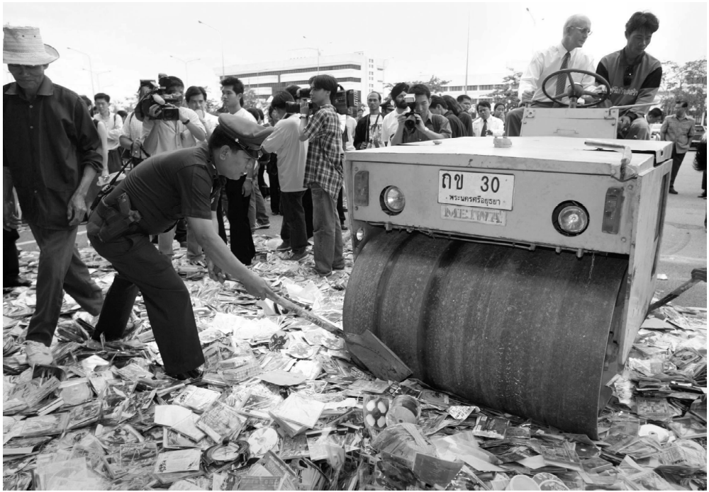
Counterfeit CDs = Lost Profits
© Reuters/CORBIS
1-<number>

Slide 39
Digital Millennium Copyright Act
First big revision of copyright law since 1976
Brought U.S. into compliance with Europe
Extended length of copyright
Extended copyright protection to music broadcast over Internet
Made it illegal for anyone to
  Circumvent encryption schemes placed on digital media
  Circumvent copy controls, even for fair use purposes
1-<number>

Slide 40
Digital Rights Management
Actions owners of intellectual property in digital form take to protect their rights
Approaches
  Encrypt digital content
  Mark digital content so devices can recognize content as copy-protected
1-<number>

Slide 41
Secure Digital Music Initiative
Goals
  Create copy-protected CDs
  Secure digital music downloads
Consortium of 200 companies developed “digital watermarking” scheme
Failed
  Internet copying became huge before SDMI ready
  Some SDMI sponsors were electronics companies
  Digital watermarking encryption cracked
1-<number>

Slide 42
Sony BMG Music Entertainment Rootkit
Millions of audio CDs shipped with Extended Copy Protection, a DRM system
Prevented users from
  Ripping audio tracks into MP3 format
  Making more than 3 backup copies
Relied upon Windows “rootkit” that hid files and processes; usually only hackers use rootkits
Huge public outcry once secret uncovered
Sony BMG stopped production and compensated consumers
1-<number>

Slide 43
Encrypting DVDs
Contents of DVDs encrypted using Content Scramble System (CSS)
Need decryption keys to view a DVD
Jon Johansen wrote a decryption program for Linux
2600 Magazine published the code
Motion picture studios sued 2600 Magazine and won
Johansen tried in Norway and found not guilty
1-<number>

Slide 44
Foiling HD-DVD Encryption
Hardware, software, and entertainment companies created Advanced Access Content System to encrypt HD-DVDs
Encryption key posted on Digg.com
AACS leaned on Digg.com to censor postings containing key
Digg users fought back
AACS “expired” the key and issued a new one
A month later, a Digg user posted the new key
1-<number>

Slide 45
Criticisms of Digital Rights Management
Any technological “fix” is bound to fail
DRM undermines fair use
DRM could reduce competition
Some schemes make anonymous access impossible
1-<number>

Slide 46
Online Music Stores Employed Digital Rights Management
When iTunes Music Store opened, all music was protected with a DRM scheme called FairPlay
FairPlay blocked users from freely exchanging purchased music
  Songs couldn’t be played on more than 5 different computers
  Songs couldn’t be copied onto CDs more than 7 times
Songs purchased from iTunes Store wouldn’t play on non-Apple devices
DRM-protected music purchased from other online retailers couldn’t be played on iPod
1-<number>

Slide 47
Online Music Stores Drop Digital Rights Management
Consumers complained about restrictions associated with DRM
European governments put pressure on Apple to license FairPlay or stop using DRM
Amazon reached an agreement with all four major music labels to sell DRM-free music
Apple followed suit in 2009
1-<number>

Slide 48
Microsoft Xbox One
Microsoft announced cloud-based gaming experience for Xbox One (June 2013)
  User could play any game without disc in tray
  Automatic software updates of every Xbox One
Controversial features of licensing arrangement
  Disc could be shared only once
  Second-hand market restricted
  Xbox consoles would have to check in every 24 hours
Microsoft backtracked
  No need to connect to Internet
  Freedom to lend, rent, buy, sell discs
  Disc must be in tray to play game
1-<number>

Slide 49
4.6 Peer-to-Peer Networks and Cyberlockers
1-<number>

Slide 50
Peer-to-Peer Networks
Peer-to-peer network
  Transient network
  Connects computers running same networking program
  Computers can access files stored on each other’s hard drives
How P2P networks facilitate data exchange
  Give each user access to data stored in many other computers
  Support simultaneous file transfers among arbitrary pairs of computers
  Allow users to identify systems with faster file exchange speeds
1-<number>

Slide 51
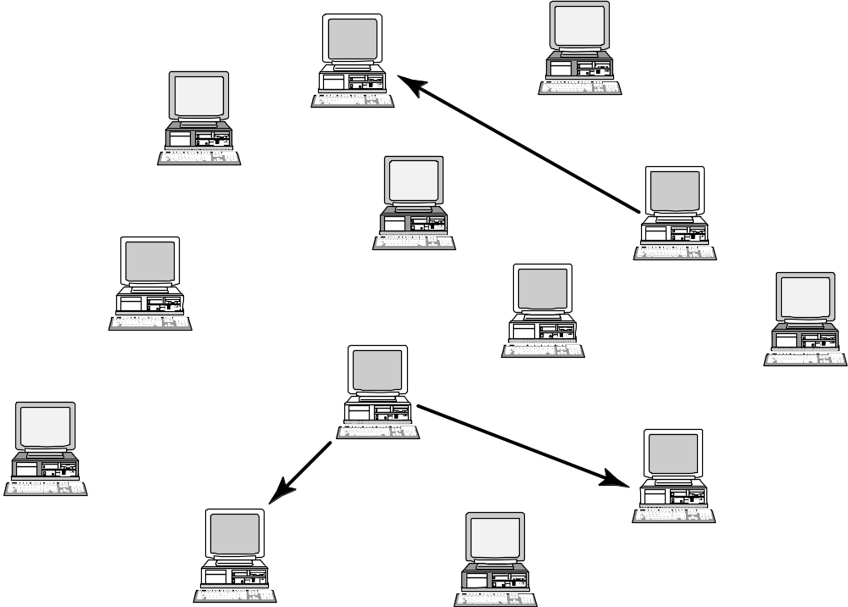
A Peer-to-Peer Network
1-<number>

Slide 52
Cyberlockers
Also called file-hosting services or cloud storage services
Internet-based file-sharing services
Allow users to upload and download password-protected files
Support workgroup collaboration
Make sharing of copyrighted material easy
1-<number>

Slide 53
Napster
Peer-to-peer music exchange network
Began operation in 1999
Sued by RIAA for copyright violations
Courts ruled in favor of RIAA
Went off-line in July 2001
Re-emerged in 2003 as a subscription music service
1-<number>

Slide 54
FastTrack
Second-generation peer-to-peer network technology
Used by KaZaA and Grokster
Distributes index among large number of “supernodes”
Cannot be shut down as easily as Napster
1-<number>

Slide 55
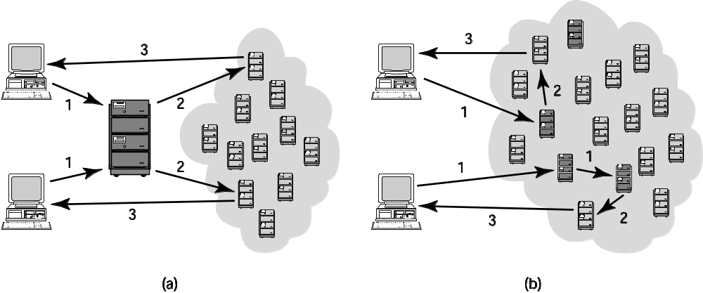
Comparing Napster and FastTrack
1-<number>

Slide 56
BitTorrent
Broadband connections: download much faster than upload
BitTorrent speeds downloading
  Files broken into pieces
  Different pieces downloaded from different computers
Used for downloading large files
  Computer programs
  Television shows
  Movies
1-<number>

Slide 57
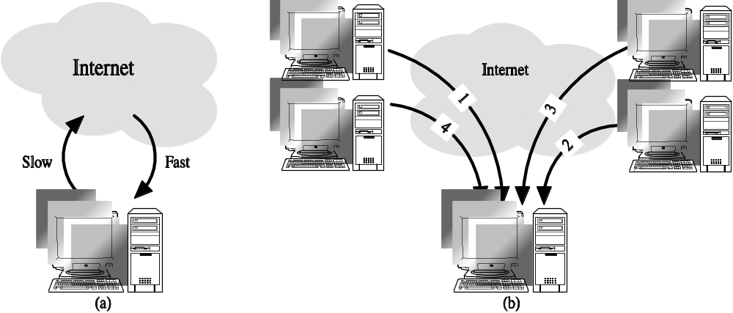
Concept Behind BitTorrent
1-<number>

Slide 58
RIAA Lawsuits
April 2003: RIAA warned file swappers they could face legal penalties
RIAA subpoenaed Verizon for identities of people suspected of running supernodes
Judge ruled in favor of Verizon
September 2003: RIAA sued 261 individuals
December 2003: U.S. Court of Appeals ruled Verizon did not have to give customer names to RIAA
1-<number>

Slide 59
Huge Jury Judgments Overturned
Jammie Thomas-Rassert
  Federal jury ordered her to pay $1.92 million
  Damages reduced to $54,000
Joel Tenenbaum
  Jury ordered him to pay $675,000
  Judge reduced award to $67,500
Does RIAA have to prove someone actually copied the songs that people made available on Kazaa?
  New York decision: No
  Massachusetts, Arizona decisions: Yes
1-<number>

Slide 60
MGM v. Grokster
Entertainment industry interests sued Grokster and StreamCast for the copyright infringements of their users
Lower courts
  Ruled in favor of Grokster and StreamCast
  Cited Sony v. Universal City Studios as a precedent
U.S. Supreme Court
  Reversed the lower court ruling in June 2005
  Proper precedent Gershwin Publishing v. Columbia Artists
1-<number>

Slide 61
Legal Action Against The Pirate Bay
The Pirate Bay started in Stockholm, Sweden
One of world’s biggest BitTorrent file-sharing sites
People download songs, movies, TV shows, etc.
After 2006 raid by police, popularity increased
In 2008 the International Federation of the Phonographic Industry sued four individuals connected with site
Defendants said The Pirate Bay just a search engine
Found guilty; sentence to prison and fined $6.5 million
Meanwhile, The Pirate Bay still operational
More than 150 proxy servers all over the world
1-<number>

Slide 62
PRO-IP Act
Gives federal law enforcement agencies right to seize domain names of sites facilitating copyright infringement
Operation In Our Sites (2010)
  Seized domain names of 10 Web sites making available full-run movies
  Seized several hundred more domain names over next 1 ½ years
1-<number>

Slide 63
Megaupload Shutdown
Megaupload a prominent cyberlocker
  More than 180 million registered users
  Once world’s 13th most popular Web site
  Source of movies, TV shows, songs, games
FBI used PRO-IP Act to shut down Megaupload (January 2012)
FileSonic and FileServe responded by disabling sharing functionality
1-<number>

Slide 64
Legal Music Services on the Internet
Subscription services for legal downloading
Some based on monthly fee; some free
Consumers pay for each download
Apple’s iTunes Music Store leading service, surpassing WalMart as top music retailer in United States
Still, illegal downloading far more popular than legal music services
1-<number>

Slide 65
4.7 Protections for Software
1-<number>

Slide 66
Software Copyrights
Copyright protection began 1964
What gets copyrighted?
  Expression of idea, not idea itself
  Object program, not source program
Companies treat source code as a trade secret
1-<number>

Slide 67
Violations of Software Copyrights
Copying a program to give or sell to someone else
Preloading a program onto the hard disk of a computer being sold
Distributing a program over the Internet
1-<number>

Slide 68
Important Court Cases
Apple Computer v. Franklin Computer
  Established that object programs are copyrightable
Sega v. Accolate
  Established that disassembling object code to determine technical specifications is fair use
1-<number>

Slide 69
Safe Software Development
Reverse engineering okay
Companies must protect against unconscious copying
Solution: “clean room” software development strategy
  Team 1 analyzes competitor’s program and writes specification
  Team 2 uses specification to develop software
1-<number>

Slide 70
Software Patents (1/3)
Until 1981, Patent Office refused to grant software patents
  Saw programs as mathematical algorithms, not processes or machines
U.S. Supreme Court decision led to first software patent in 1981
Further court rulings led to patents being granted for wider range of software
1-<number>

Slide 71
Software Patents (2/3)
Thousands of software patents now exist
  Microsoft files ~3,000 applications annually
  Licensing patents a source of revenue
Secondary market for software patents
  Patent trolls: Companies that specialize in buying patents and enforcing patent rights
  Companies would rather settle out of court than spend time and money going to trial
  RIM didn’t settle quickly; ended up paying $612 million
1-<number>

Slide 72
Software Patents (3/3)
Critics say too many patents have been issued
  Patent Office doesn’t know about prior art, so it issues bad software patents
  Obvious inventions get patents
Companies with new products fear getting sued for patent infringement
  Build stockpiles of patents as defense mechanism
  Software patents used as legal weapons
Bezos: software patents should expire in 3-5 years
1-<number>

Slide 73
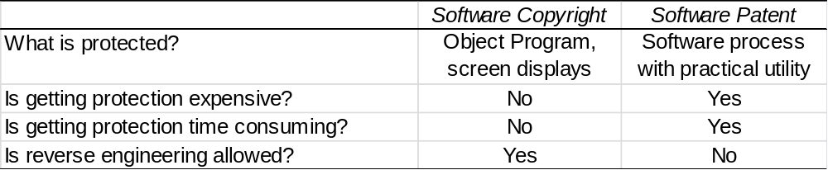
Key Differences between Software Copyrights and Software Patents
1-<number>

Slide 74
4.8 Open-Source Software
1-<number>

Slide 75
Criticisms of Proprietary Software
Increasingly harsh measures being taken to enforce copyrights
Copyrights are not serving their purpose of promoting progress
It is wrong to allow someone to “own” a piece of intellectual property
1-<number>

Slide 76
Open-Source Definition
No restrictions preventing others from selling or giving away software
Source code included in distribution
No restrictions preventing others from modifying source code
No restrictions regarding how people can use software
Same rights apply to everyone receiving redistributions of the software (copyleft)
1-<number>

Slide 77
Beneficial Consequences of Open-Source Software
Gives everyone opportunity to improve program
New versions of programs appear more frequently
Eliminates tension between obeying law and helping others
Programs belong to entire community
Shifts focus from manufacturing to service
1-<number>

Slide 78
Examples of Open-Source Software
BIND
Apache
Sendmail
Android operating system for smartphones
Firefox and Chrome
OpenOffice.org
Perl, Python, Ruby, TCL/TK, PHP, Zope
GNU compilers for C, C++, Objective-C, Fortran, Java, and Ada
1-<number>

Slide 79
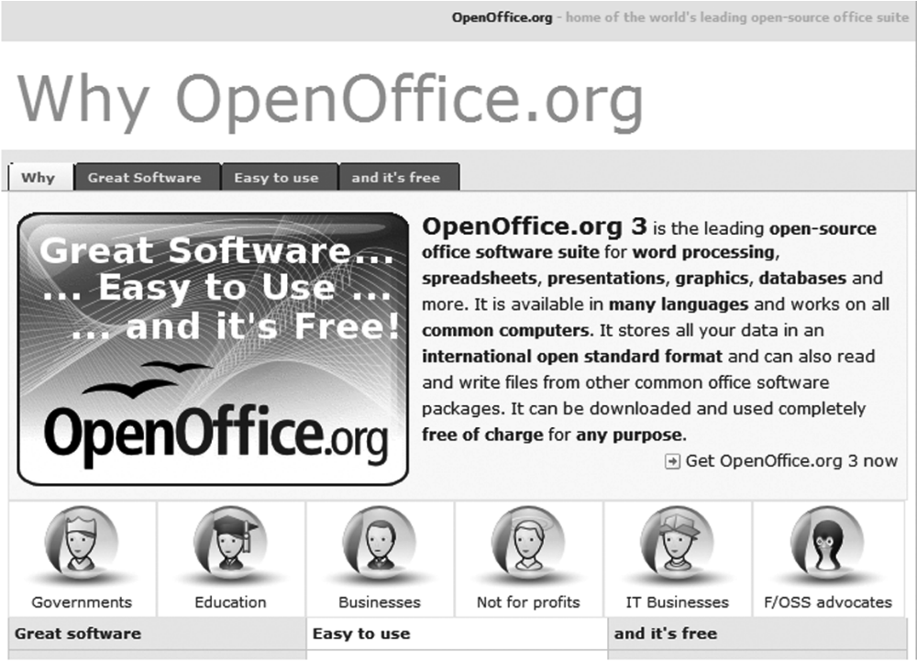
Screenshot from OpenOffice.org, a registered trademark of Apache Software Foundation. Copyright © 2012 by Apache Software Foundation. Reprinted with permission.
1-<number>

Slide 80
GNU Project and Linux
GNU Project
  Begun by Richard Stallman in 1984
  Goal: Develop open-source, Unix-like operating system
  Most components developed in late 1980s
Linux
  Linus Torvalds wrote Unix-like kernel in 1991
  Combined with GNU components to make an O.S.
  Commonly called Linux
1-<number>

Slide 81
Impact of Open-Source Software
Linux an alternative to proprietary versions of Unix
Linux operating system on 95% of the world’s 500 fastest supercomputers
1-<number>

Slide 82
Crititique of the Open-Source Software Movement
Without critical mass of developers, quality can be poor
Without an “owner,” incompatible versions may arise
Relatively weak graphical user interface
Poor mechanism for stimulating innovation (no companies will spend billions on new programs)
1-<number>

Slide 83
4.9 Legitimacy of Intellectual Property Protection for Software
1-<number>

Slide 84
Do We Have the Right System in Place?
Software licenses typically prevent you from making copies of software to sell or give away
Software licenses are legal agreements
Not discussing morality of breaking the law
Discussing whether society should give intellectual property protection to software
1-<number>

Slide 85
Rights-based Analysis
“Just deserts” argument
  Programming is hard work that only a few can do
  Programmers should be rewarded for their labor
  They ought to be able to own their programs
Criticism of “just deserts” argument
  Why does labor imply ownership?
  Can imagine a just society in which all labor went to common good
  Intellectual property not like physical property
1-<number>

Slide 86
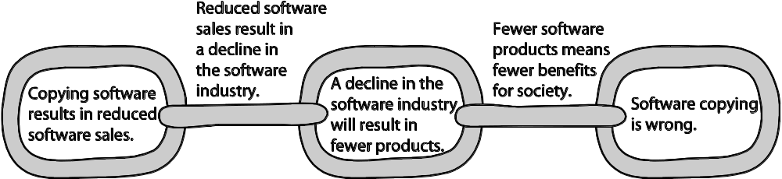
A Consequentialist Argument Why Software Copying Is Bad
Beth Anderson
1-<number>

Slide 87
Utilitarian Analysis
Argument against copying
  Copying software reduces software purchases…
  Leading to less income for software makers…
  Leading to lower production of new software…
  Leading to fewer benefits to society
Each of these claims can be debated
  Not all who get free copies can afford to buy software
  Open-source movement demonstrates many people are willing to donate their software-writing skills
  Hardware industry wants to stimulate software industry
  Difficult to quantify how much society would be harmed if certain software packages not released
1-<number>

Slide 88
Conclusion
Natural rights argument weak
Utilitarian argument not strong, either
Nevertheless, society has granted copyright protection to owners of computer programs
Breaking the law is wrong unless there is a strong overriding moral obligation or consequence
1-<number>

Slide 89
Case Study: The Database Guru
Salam worked for five years at Felicity Software, where he developed software optimizations that significantly improved the company’s database performance.
Felicity treated these optimizations as confidential trade secrets, limiting access to only Salam and a few engineers.
Salam signed a confidentiality and proprietary rights agreement on his first day, agreeing not to disclose company secrets during or after employment.
The agreement emphasized Felicity’s commercial value in protecting trade secrets and prohibited Salam from sharing or publishing confidential information externally.
1-<number>

Slide 90
Salam left Felicity and was quickly hired by Unrelated.com, a start-up building a genealogical database platform with a subscription model.
Unrelated.com’s business model depends on high-performance database systems to support 50,000 subscribers and up to 10,000 simultaneous users.
As VP of Software with a $150,000 salary, Salam oversees teams developing and optimizing the new database system.
Salam realizes that the team’s current technical solutions won’t meet the performance goals, as they can only support around 5,000 concurrent users.
1-<number>

Slide 91
He considers two options:
  A “clean-room” strategy — guiding the team using public knowledge and performance targets.
  Indirectly leading the team to rediscover his Felicity optimizations without directly revealing trade secrets.
Salam faces an ethical and legal dilemma: respecting his confidentiality obligations while ensuring Unrelated.com’s project succeeds.
1-<number>

Slide 92
1. He would have access to confidential, secret, and proprietary information related to Felicitys business.
2. Felicity placed great competitive importance and commercial value on its ability to reserve confidential
information for its exclusive use.
3. Confidential information he developed would be covered by this agreement.
4. He would not directly or indirectly disclose, publish, communicate or make available confidential information to anyone outside of the company.
5. His obligations under the agreement would continue during and after his employment by Felicity
1-<number>

Slide 93
4.10 Creative Commons
1-<number>

Slide 94
Streamlining Creative Re-use
Under current copyright law, eligible works are copyrighted the moment they are created
No copyright notice does not mean it’s okay to copy
Must contact people before using work
That slows down creative re-use
Free Creative Commons license indicates
  Which kinds of copying are okay
  Which rights are being retained
Flickr and Magnatune two well-known sites using Creative Commons licenses
1-<number>

Slide 95
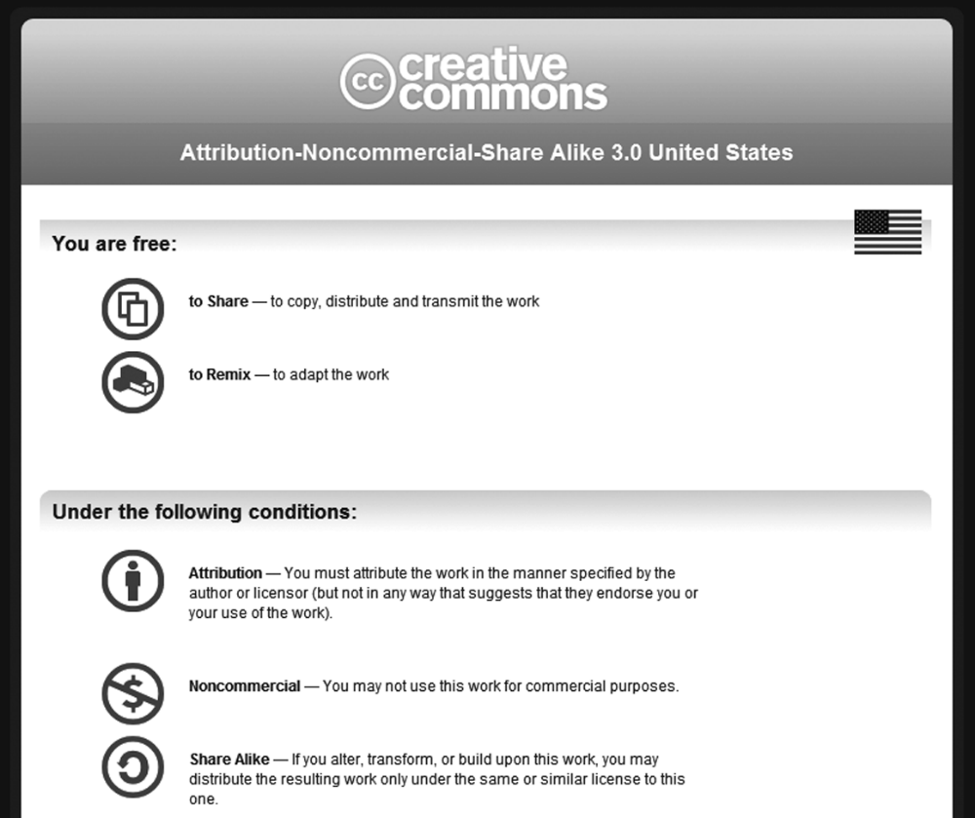
1-<number>
Screenshot from Creative Commons. Copyright © 2011 by Creative Commons. Reprinted with permission.

